Slide 1

Duncan Flood Mitigation
Engineers: Andrew Smith, Colin Bitsoie, Sydney Schumacher, Thomas Whelan
Client: Greenlee County Engineer, Phillip Ronnerud, PE
Technical Advisor: Tom Loomis, PE
Grading Instructor: Dr. Odem

Slide 2
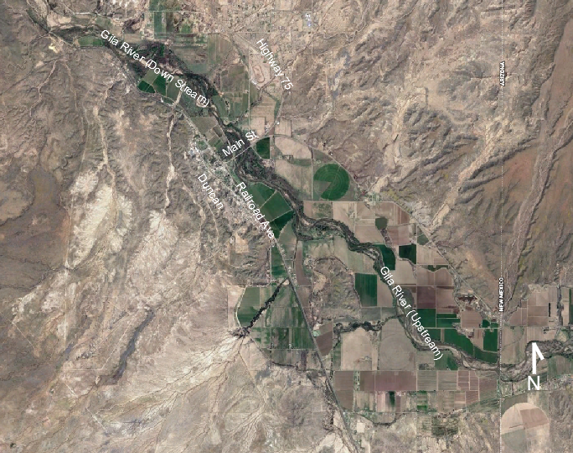
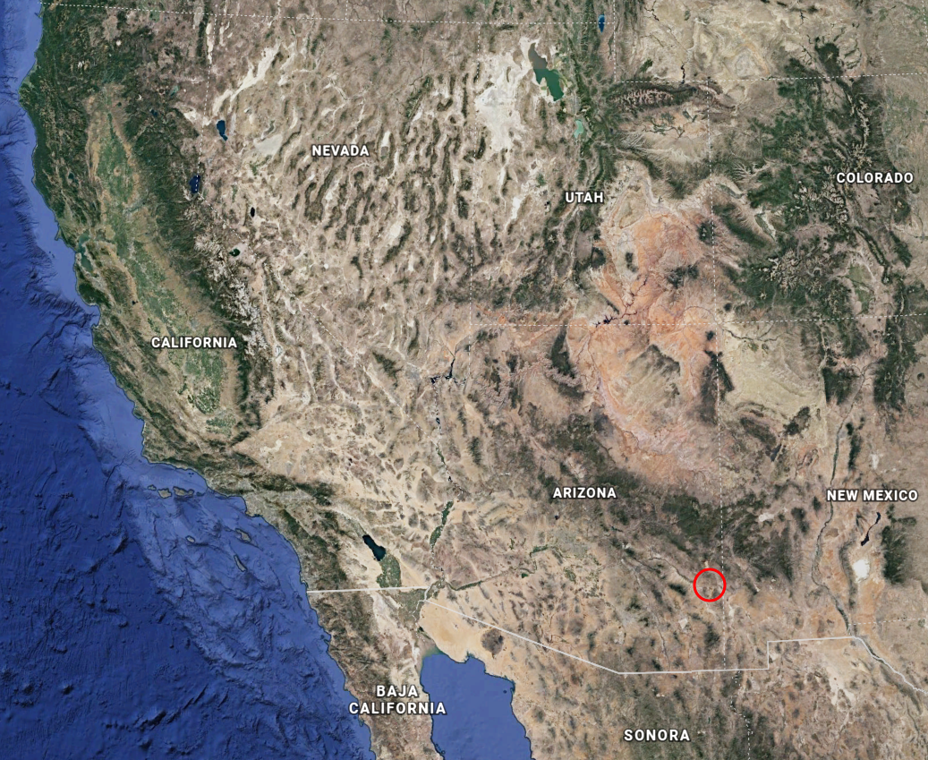
Project Location
Figure 1: Project Location: Duncan, Arizona [1]
Figure 2: Duncan, Arizona and portion of Gila River [1]
Bitsoie
Notes:
Duncan is located in Greenlee County, Arizona, United States on the border of new mexico and arizona, on the gila river
Home to approximately 800 people

Slide 3
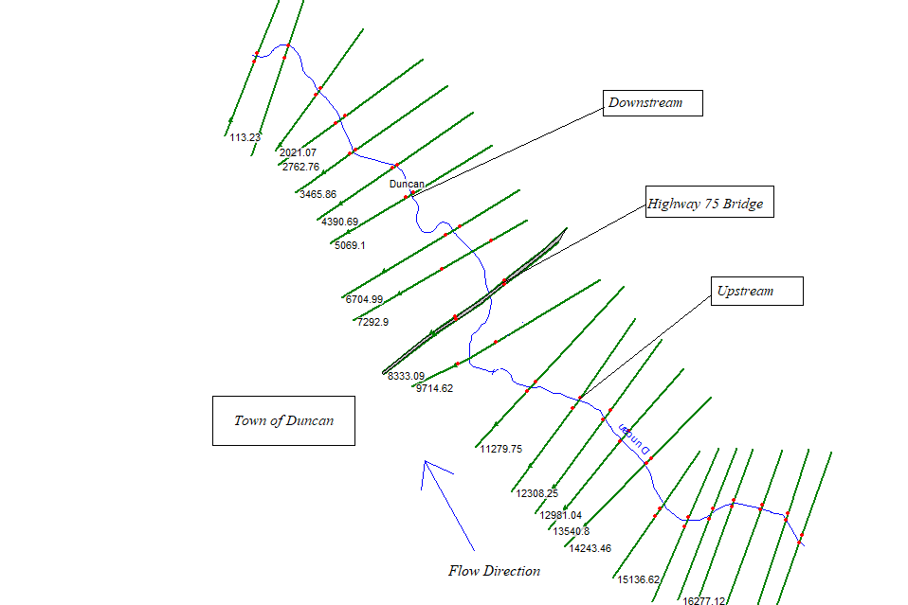
Project Overview
Design flood protection for 100 year storm: 48,000 cfs
Improve Bridge Hydraulics at Highway 75 Bridge
Length of interest along Gila River
Approximately 18,000 feet
Meets needs of the general public (Duncan)
Farmers, miners, and property owners
Economics and Ecology
Figure 3: River Area of Interest
Bitsoie

Slide 4
Modeling Applications
QGIS (Quantum Geographic Information System)
Evaluate the effectiveness of levee placement
HEC-RAS (Hydrologic Engineering Center’s River Analysis System)
Bridge hydraulics improvements
One dimensional model
Obtain water depth for levee
FLO-2D (Two-dimensional Flood Routing Model)
Analysis of the effectiveness of the design using the input data from HEC-RAS and QGIS.
FLO- 2D
QGIS
HEC-RAS
Figure 4: Modeling Application Flowchart
Bitsoie

Slide 5
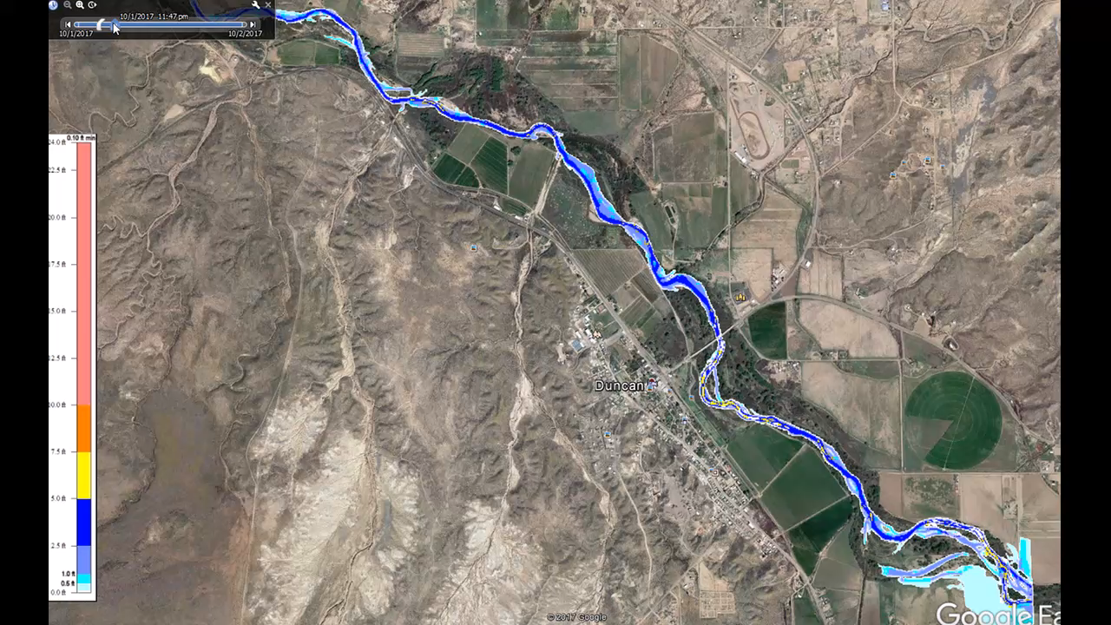
Base Model
Whelan

Slide 6
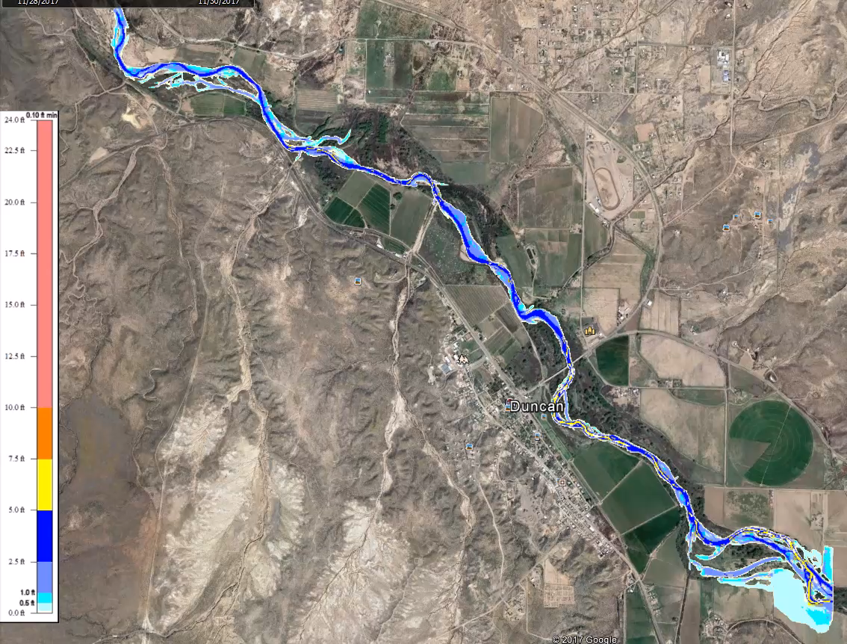
Levee/Highway Alignment
Whelan

Slide 7
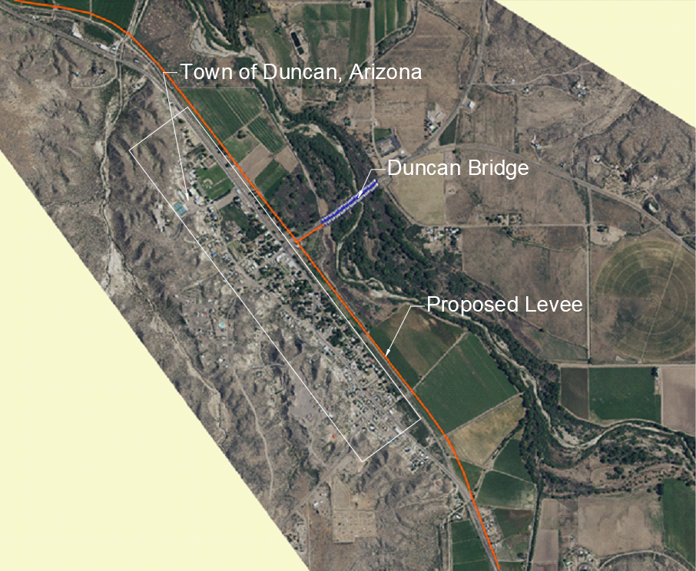
Proposed Solution: Levee/Highway Alignment
Highway 70 Levee/Highway
Height: 8.5 feet above existing ground surface and at bridge
Width: Approx. 101 feet (max)
Length: 2.75 miles
Meets the following project goals:
Protects town against 100 year flood
Potential ADOT funding
No significant changes to channel shape
Figure 5: Proposed Solution: Highway Alignment
Whelan
Notes:
1.Reinforced Existing: all levees along the bank have been enhanced.
2.EnhancedBridgeLevee: only a levee along the bridge, testing for water depth
3.HighwayAlignmentWithBridgeLevee: an alignment with a roadway that
parallels the railroad, with a levee that connects to the bridge.
4.HighwayAlignment: levee that parallels the railroad to simulate a highway

Slide 8
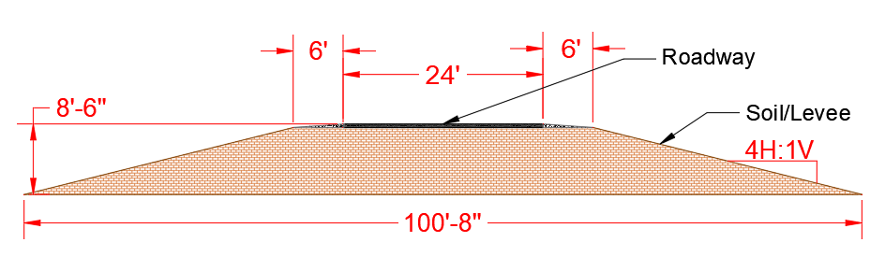
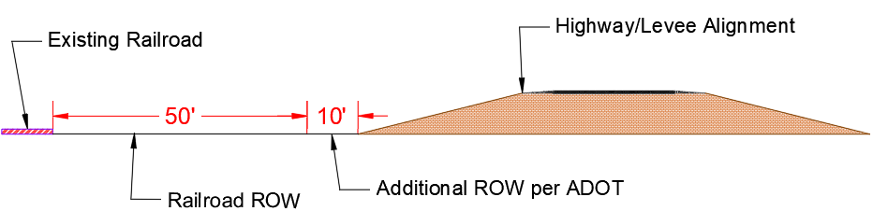
Highway/Levee Alignment Constraints
Minimum right of way declared for railroad: 50’
Additional right of way required from toe of fill slope of ROW railroad: 10’
Grading distance from edge of pavement range from 60’ to 94’
ADOT regulations govern 4:1 slope and typical roadway layout
Figure 6: AutoCAD Representation of Roadway Cross Section
Figure 7: AutoCAD representation of ROW offset from railroad to roadway
Whelan

Slide 9
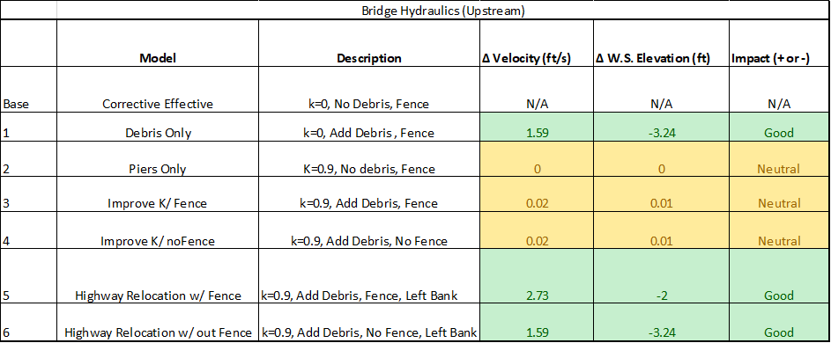
HEC-RAS
Table 1: HEC RAS Bridge Results (Upstream)
Six HEC-RAS models
Used to:
Improve Bridge Hydraulics
Calculate Water Height against Levee
Subcritical flow regime (naturally)
Schumacher
Notes:
-K:friction losses around different shapes
-Toms suggested modeling best option and seeing what happens
-Debris (10 by 10) for middle piers (Phil said to double width and height is a educated guess
-floating mass of primarily Willow and cottonwood with salt cedar and other debris intertwined.
-Height is about 10 feet in built up areas (applied to middle piers and disperses as we move down)

Slide 10
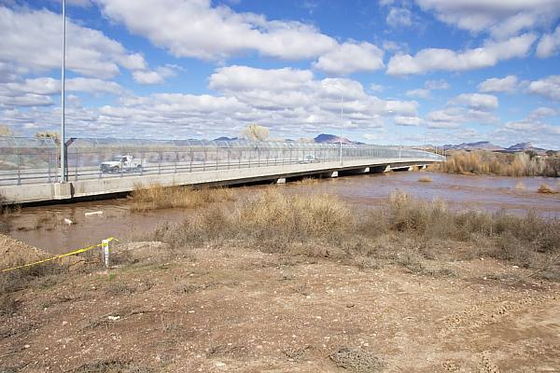
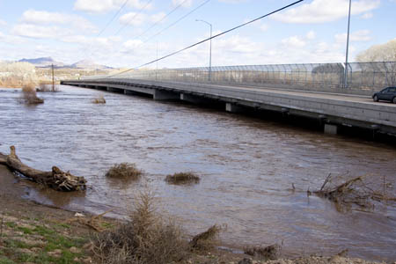
Highway 75 Bridge Fence
Figure 8: Upstream of Bridge [2]
Figure 9: Downstream of Bridge [3]
Schumacher
Notes:
What storm was this? Peak discharge? Add to title of slide? Arrow to the fence?

Slide 11
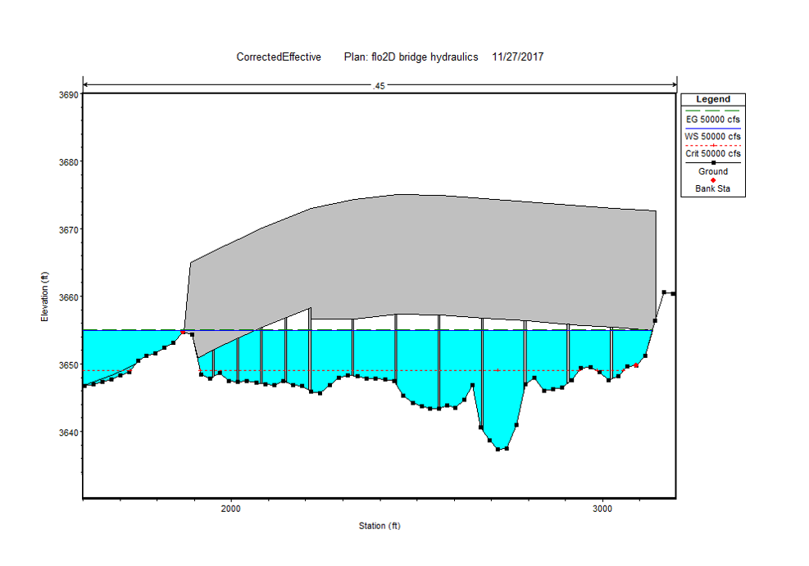
Corrective Effective Model
HEC-RAS Base Model of Highway 75 Bridge
Fence remains
No pier shape coefficient (K) value
No debris added to Piers
Froude number: Min (0.13) before bridge and Max (0.74) downstream
Velocity: 2.28 ft/s
Water Surface Elevation: 3654.93 feet
Bridge and Fence
Figure 10: HEC-RAS Base Model
Schumacher

Slide 12
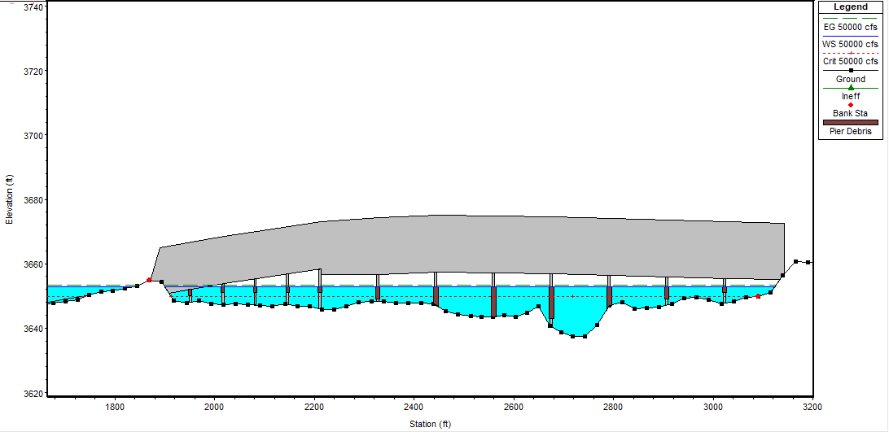
HEC-RAS Results with Fence
HEC-RAS Highway Alignment with Fence
Pier shape (K)= 0.9 (semi- circular nose and tail)
Debris added (10’ X 10’ on thalweg)
Fence remains
Matches levee alignment on left bank
Velocity: 5.01 ft/s (+2.28ft/s)
WS ELEV: 3652.93 (-2.0 ft)
Left Bank Set to Alignment
Pier Shape Changed
Debris Added
Figure 11: HEC-RAS Highway Alignment with Fence
Schumacher
Notes:
This slide is how the model affects the different flow characteristics at the bridge.
0.9 is the most efficient pier shape
50,000 CFS is the flow rate in the channel

Slide 13
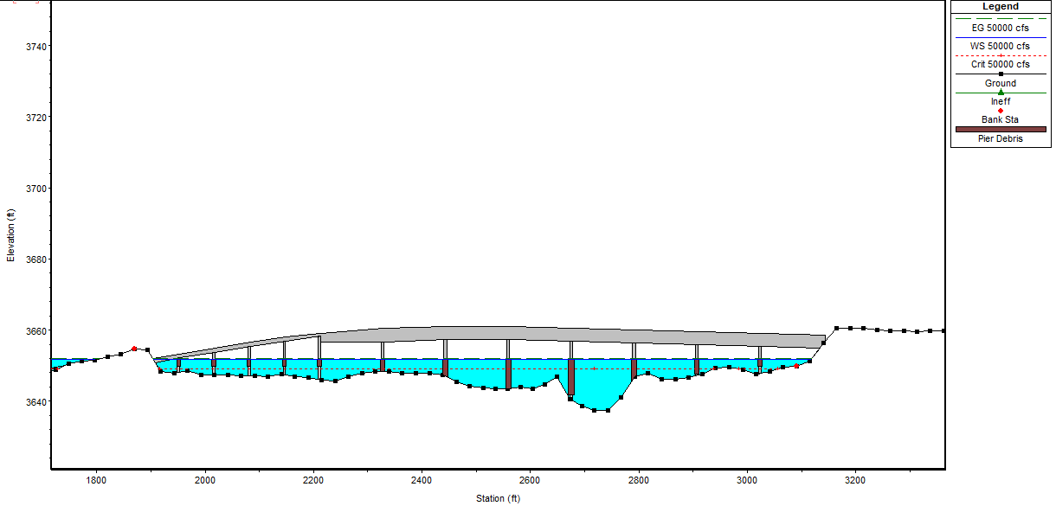
HEC-RAS Bridge Results Without Fence
Alignment without Fence
K=0.9
Debris remains
Fence removed
Left bank set to highway alignment
Froude number: Min (0.23) before bridge and Max (0.75) further downstream
Velocity: 3.87 (+1.59 ft/s)
WS Elev: 3651.69 (-3.24 ft)
Fixed Left bank at Alignment
Pier Shape Changed
Debris Added
Figure 12: HEC-RAS Highway Alignment Model without Fence
Schumacher

Slide 14
Schedule
Table 2: Completed Schedule
Task | Start Date | End Date
1.0 Modeling Parameters
1.1 Learning Software | 8/29/2017 | 11/17/2017
1.2 Bridge/Levee Alternatives | 9/12/2017 | 9/12/2017
1.3 Regulation Research | 3/2/2016 | 12/5/2017
2.0 Modeling
2.1 HEC-RAS | 9/8/2017 | 11/17/2017
2.2 Q GIS | 9/8/2017 | 11/17/2017
2.3 FLO 2D | 10/4/2017 | 11/17/2017
3.0 Modeling Analysis
3.1 Recommended Solutions | 9/14/2017 | 11/29/2017
3.2 Impacts | 11/30/2017 | 12/6/2017
3.3 Cost Analysis | 11/30/2017 | 12/6/2017
4.0 Data Collection
4.1 Site Visit (Travel) | 3/3/2017 | 3/4/2017
4.2 Public Forum | 3/4/2017 | 3/4/2017
4.3 Explore Data Files | 5/8/2017 | 11/17/2017
5.0 Project Management
5.1 Coordination | 1/25/2016 | 12/15/2017
5.2 50% Report | 10/1/2017 | 10/16/2017
5.3 Impacts Report | 11/1/2017 | 11/13/2017
5.4 Final Proposal | 12/12/2017 | 12/12/2017
Smith
14

Slide 15
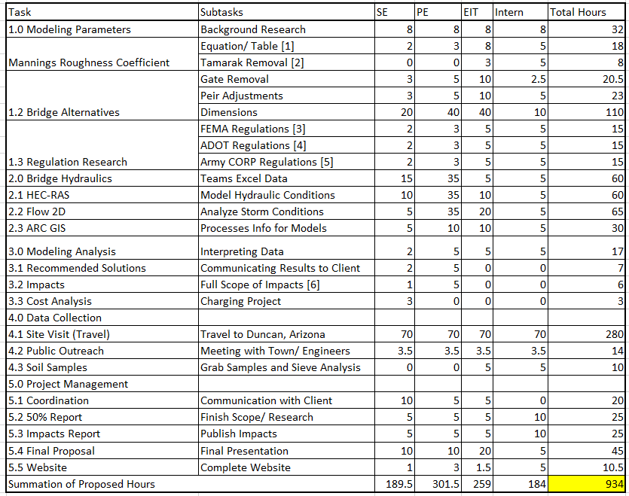
Proposed Hours
Table 3: Proposed Staffing Hours
15
Smith

Slide 16
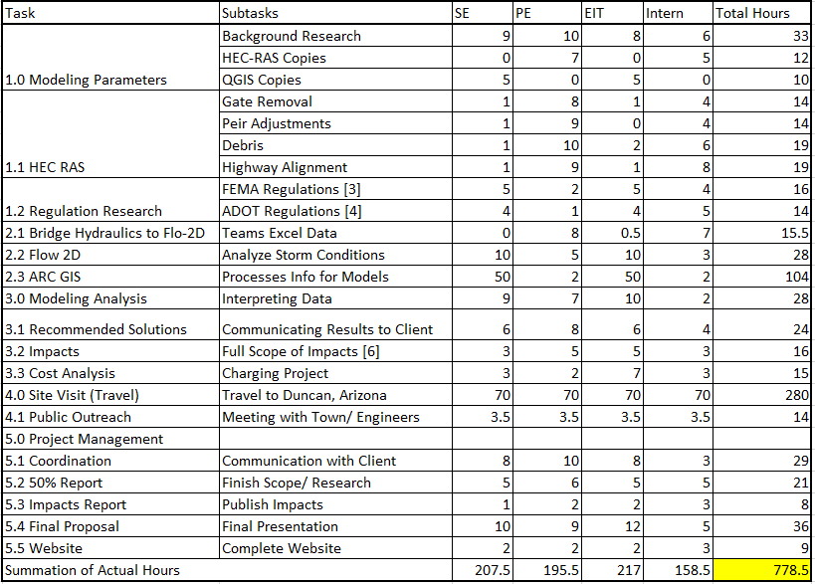
Actual
Hours
Table 4: Actual Staffing Hours
16
Smith

Slide 17
Staffing
Table 5: Responsibilities of Position
Table 6: Staffing Cost
Position | Qualification
Project Engineer 1 | Construction Management
 | Editing
 | Public Speaking/ Group Communicator
 | Plan analyzer
 | HEC-RAS Modeling
Senior Engineer | ARCGIS Background
 | Understanding Sitemaps
 | Project Researcher
 | QGIS Modeling
 | Flo-2D Modeling
Intern | Open Channel Analysis Background
 | HEC-RAS Modeling
 | Regulation Research
EIT | ARCGIS Background
 | Understanding Sitemaps
 | Project Researcher
 | QGIS Modeling
 | Flo-2D Modeling
Classification | Billing Rate ($)/hr | Projected Hours | Total Projected Cost ($) | Actual Hours | Total Actual Cost ($)
Senior Engineer | 130 | 128 | 16640 | 207.5 | 26975
Project Engineer 1 | 90 | 126 | 11340 | 195.5 | 17595
EIT | 75 | 133.5 | 10012.5 | 217 | 16275
Intern | 25 | 50 | 1250 | 158.5 | 3962.5
Total Staff Cost |  | 437.5 | 39242.5 | 778.5 | 64807.5
Travel (2 Trips) | $/(mile or day) | Miles or Day | Total Cost ($) | Miles or Day | Total Cost ($)
Miles | 0.5 | 1400 | 700 | 1400 | 700
Rental Car | 40 | 4 | 160 | 4 | 160
Hotel | 50 | 5 | 250 | 5 | 250
Totals |  | 1846.5 | 40352.5 | 2187.5 | 65917.5
17
Smith

Slide 18
Cost Analysis
The total estimated cost of construction is $13.8 million
The estimated cost for maintenance is $21,000 per year [11]
Table 7: Project Cost
Component | Quantity |  | Unit Cost |  | Total Cost
Highway | 2.75 | miles | $2,500,000 | per mile | $6,875,000
Land Acquisition | 45.1 | Acre | $5,755 | per Acre | $259,551
Erosion Control | 247,197 | ft^2 | $3 | per ft^2 | $741,591
Levee Cost |  |  |  |  | $4,308,124
Staffing |  |  |  |  | $65,917
Construction Management |  |  |  |  | $1,523,033
Total Cost |  |  |  |  | $13,773,216
Table 8: Levee cost [12 -15]
Component | Quantity |  | Unit Cost |  | Total Cost
Embankment Fill | 84,834 | yd^3 | $13 | per yd^3 | $3,478,204
Scur concrete Lining | 14,820 | yd^3 | $56 | per yd^3 | $829,920
Hauling Service |  |  | $28 | per yd^3
Total Levee Cost |  |  |  |  | $4,308,124
Smith

Slide 19
Impacts
Environment
Migratory birdwatching
Local plants
River flow characteristics
Economics
1978 flood had $9 million in damages to the town[17]
Adjusting the cost of damages for inflation the damages would be $35.5 million
The cost of project $13.8 million
Social
Removal of farm fields negatively impact livelihood and politics in the area
Easements would be required for this design
Smith

Slide 20
Next Steps
Multi-disciplinary Team
Roadway geometrics and profile
Erosion control on levee
Intersection geometry at Hwy 75
Floodgate to prevent water from entering the town
Transition over railroad at the north end
Smith

Slide 21
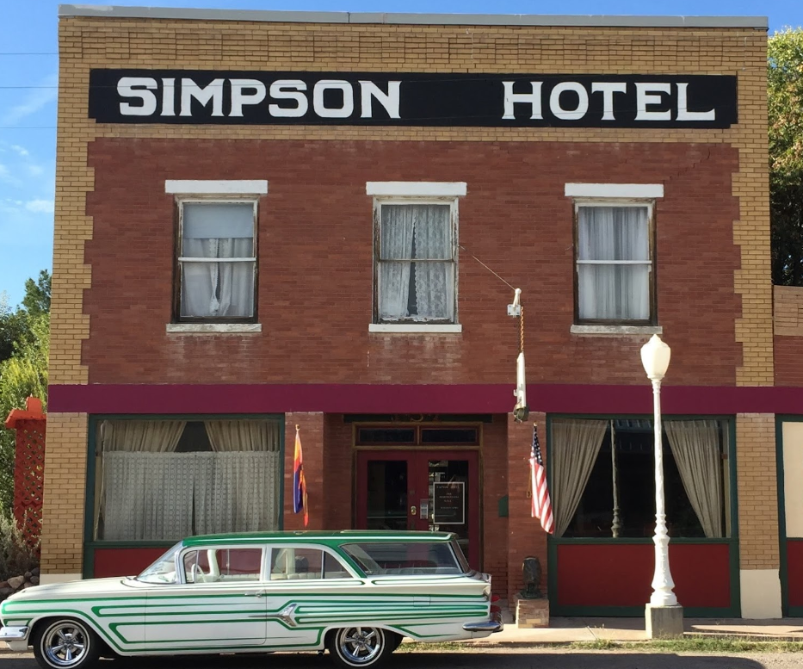
Acknowledgements
Phillip Ronnerud
Tom Loomis
Town of Duncan, Arizona
Simpson Hotel
Figure 13: Simpson Hotel located in Duncan, Arizona [18]
Smith

Slide 22
Questions?

Slide 23
References
[1] Project Location. Google Earth. 2017
[2] (2005). Available: http://www.rshantz.com/Scenes/Arizona/Southeast/20050213GilaFlood/20050213Flood11N.jpg
[3] (2017). duncan arizona flooding - Google Search. [online] Available at: https://www.google.com/search?q=duncan+arizona+flooding&rlz=1C1GGRV_enUS760US760&source=lnms&tbm=isch&sa=X&ved=0ahUKEwi7qqbI99_XAhWKhVQKHT9iBM0Q_AUICygC&biw=1920&bih=984#imgdii=2IR78UpNSA-gNM:&imgrc=H9OInIRjGcwL4M [Accessed 30 Nov. 2017].
[4] Gila River Bridge #311. (2003). Arizona: ADOT, pp.42-70.
[5] Hydraulic Reference Manual. (2016). Davis, California: US Army Corp.
[6] QGIS. (2017). Las Palmas de G.C.
[7] “Duncan.” 32°43’ 50” N and 109 °05’ 48.18” W. Google Earth. March 21, 2015. October 8th, 2017.
[8] AutoCAD 2017. AutoDesk, 2017.
[9] FEMA, “Chapter 5- Barriers” [Online] Available: https://www.fema.gov/media-library-data/20130726-1608-20490-6445/fema551_ch_05.pdf
[10] ARTBA “Frequently asked Questions” [online] Available: https://www.artba.org/about/faq/
[11] Operational Maintenace Level “Average Cost for Road Maintenance” [Online] Available: https://www.fs.usda.gov/Internet/FSE_DOCUMENTS/fseprd528063.pdf
[12] CostHelper. (2017). How Much Does Soil Cost? - CostHelper.com. [online] Available at: http://home.costhelper.com/soil.html [Accessed 30 Nov. 2017].Soil Cost Available: http://home.costhelper.com/soil.html
[13] Fleetfarm.com. (2017). QUIKRETE Concrete Mix. [online] Available at: https://www.fleetfarm.com/detail/quikrete-concrete-mix/0000000227818?gclid=CjwKCAiA9f7QBRBpEiwApLGUiqqXfa8rDW_1RKjj0rma4ktHVFYdjN7SZeHbGvcwNnSNEj-j25XsUBoCq54QAvD_BwE
[14] List, A. (2017). Dollar per truck load of fill dirt . [online] Answers.angieslist.com. Available at: http://answers.angieslist.com/per-truck-load-fill-dirt-q101209.aspx [Accessed 30 Nov. 2017].
[15] Landwatch.com. (2017). Duncan, Greenlee County, Arizona Land for sale, Duncan, Greenlee County, Arizona Acreage for Sale, Duncan, Greenlee County, Arizona Lots for Sale at LandWatch.com. [online] Available at: https://www.landwatch.com/Arizona_land_for_sale/Duncan [Accessed 30 Nov. 2017].
[16] Homewyse. (2017). Homewyse Calculator: Cost to Install Erosion Control Mesh. [online] Available at: https://www.homewyse.com/services/cost_to_install_erosion_control_mesh.html [Accessed 30 Nov. 2017].
[17] Arizona Department of Water Resources, Reconnaissance Report of the Gila River Flood COntrol Project, 1981.
[18] Media-cdn.tripadvisor.com. (2017). Simpson Hotel Duncan. [online] Available at: https://media-cdn.tripadvisor.com/media/photo-s/09/53/c0/ff/simpson-hotel.jpg [Accessed 1 Dec. 2017].

